Slide 1
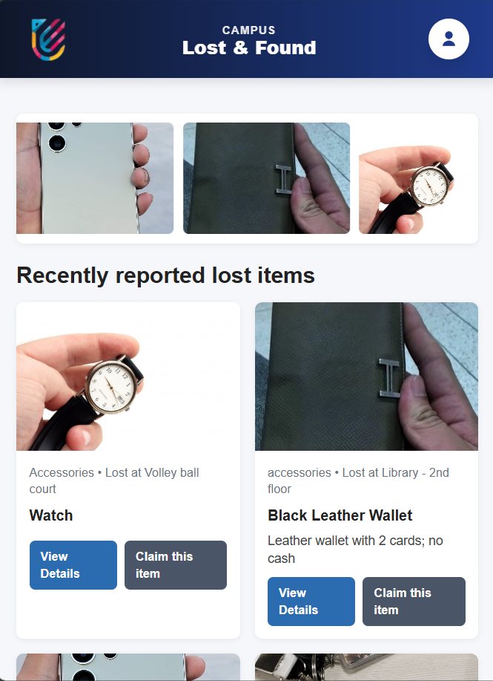
Campus Lost & Found Management System
A DBMS Project using MySQL
Presented by: Shekhar & Krishna Baura
SAP ID: 590016074 & 590015488

Slide 2

The Challenge: Navigating Campus Losses
Frequent Losses
Students often misplace personal belongings across the expansive campus.
Inefficient Manual Processes
Traditional manual registers are slow, prone to errors, and difficult to manage.
Lack of Centralization
No unified platform exists for students to check for or claim lost items.
Slow Matching
Connecting lost items with their rightful owners is currently a tedious and unreliable process.

Slide 3





Introducing the System
Web & Mobile Access
Student Engagement
Admin Management
A user-friendly website for all lost and found activities. Anyone can access it form a phone or computer.
Students can view items and submit claims directly if the item belongs to them.
Administrators have special tool to manage all items and claims efficiently.
Structured Data
Audit Logs
All the information is safely stored in strong MySQL database so the data stays organized and secure.
The system keeps automatic records of all the important actions. So that everything keep in tracked.

Slide 4

Database Structure
A well-structured database underpins the entire system, ensuring data integrity and efficient retrieval.
1
Key Tables
We have used admin, items, claims, audit_log tables in our database.
2
Defined Relationships
One administrator can manage multiple items, and each item can receive multiple claims.
3
Normalization
We made sure that the data stays consistent and reduce redundancy.
4
ENUM Fields
Used to restrict values for better data validation and integrity.

Slide 5





System Architecture Overview
Our system follows a client-server model, ensuring a seamless flow of information.
Browser
PHP Backend
User interface for interaction.
Handles logic and data processing.
MySQL Database
Audit Logs
Stores all system data securely.
Records all significant actions.
Frontend Technologies
Backend & Database
HTML for structure
PHP with prepared statements for security
CSS for styling
MySQL with triggers for data integrity
JavaScript for interactivity

Slide 6
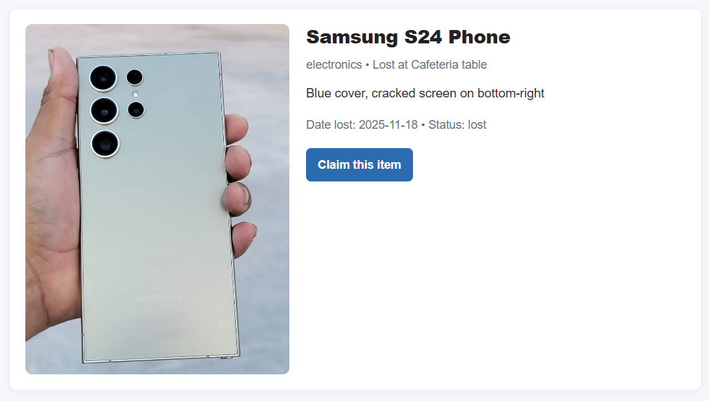
Intuitive Frontend Implementation
Designed for ease of use, providing a clean and responsive experience for students and admins.
1
Modern UI
Sleek and contemporary design for an engaging user experience.
2
Modular CSS
Separate stylesheets for each page ensure maintainability and organization.
3
Dynamic Banner
An auto-scrolling banner highlights new or important lost items.
4
Responsive Cards
Items displayed in an adaptable card layout, perfect for any device.
5
Clean Detail Pages
Dedicated pages for each item, presenting information clearly and concisely.

Slide 7
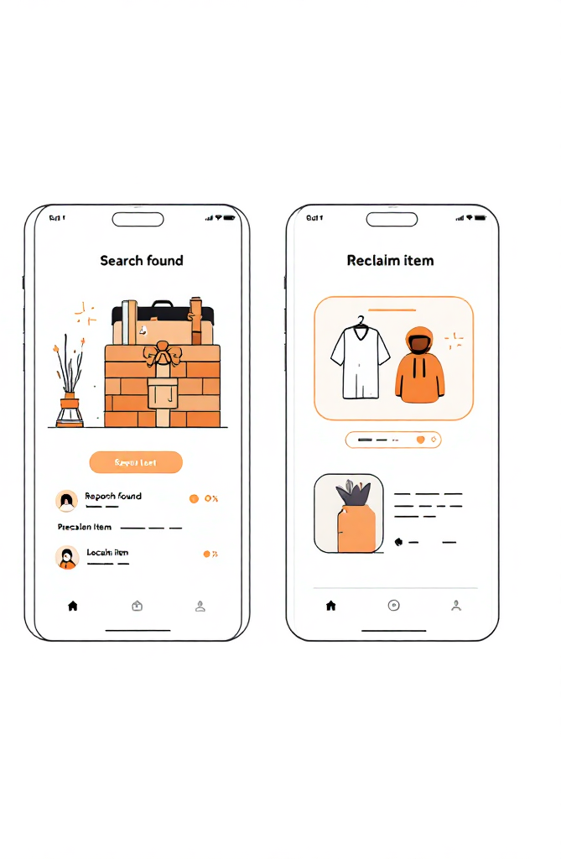
Case Study: Campus Lost & Found
Add Lost Item
Quickly submit details and photos of what's missing.
Search Found Items
Browse reported found items and request for claim.
Reclaim with Safe Handover
Securely retrieve your item with verified identity.

Slide 8
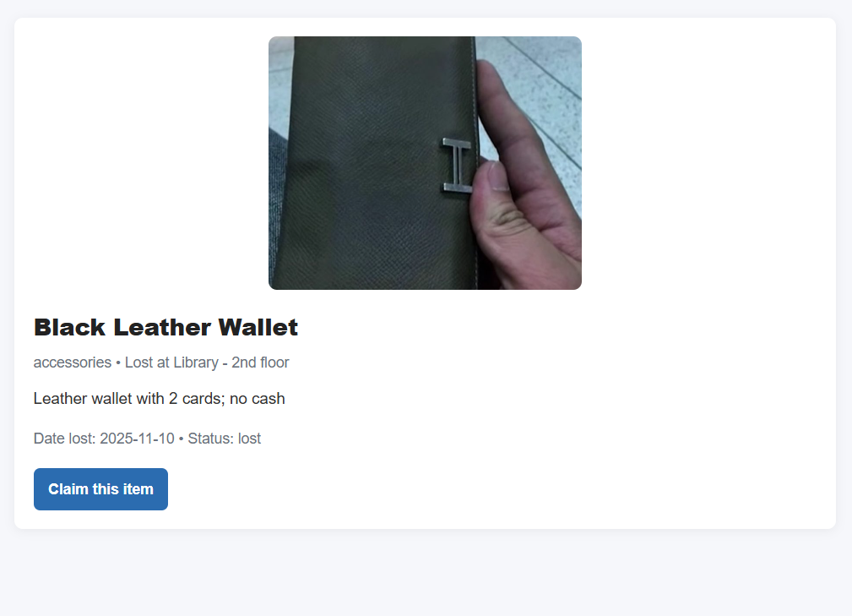

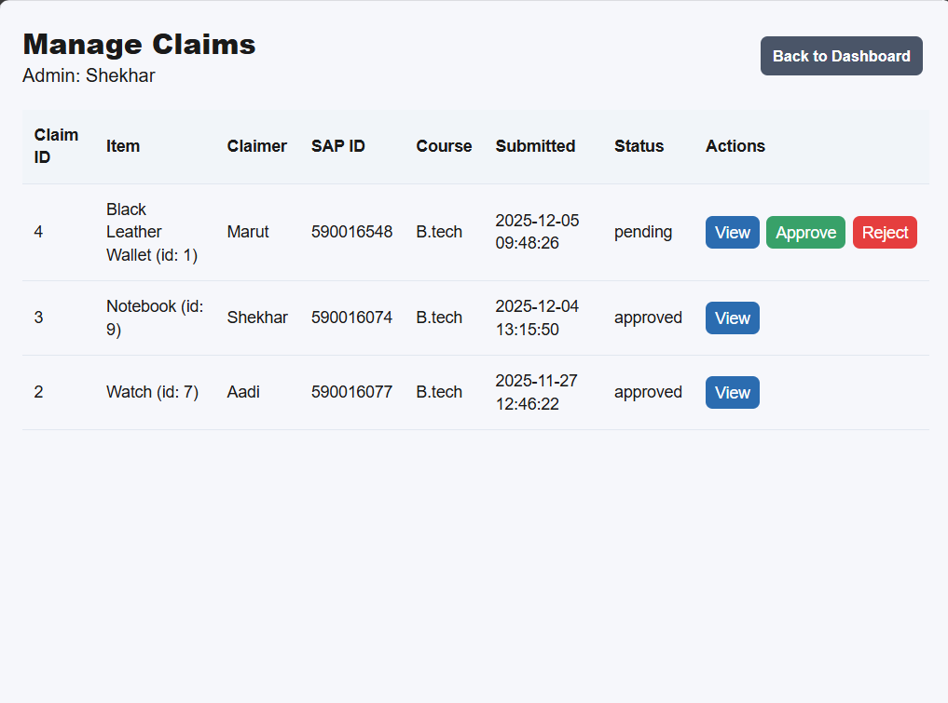
Streamlined Claim Workflow
A clear and efficient process for students to reclaim their lost items.
User Views Item
Students browse the available lost items on the portal.
Submits Claim
The user files a claim, optionally providing proof of ownership (e.g., photos, detailed description).
Admin Reviews
An administrator carefully evaluates the submitted claim and proof.
Action & Log
The admin approves or rejects the claim, with the action automatically logged for transparency.

Slide 9

Automated Audit Logging
Ensuring transparency and accountability for every administrative action.
MySQL Triggers
Automatically records INSERT, UPDATE, and DELETE operations.
Track All Actions
Every administrative modification to the database is carefully recorded.
Accountability
Ensures all data changes are properly recorded for better accountability.
Transparency
Creates transparent proof of activities, which builds user confidence.

Slide 10


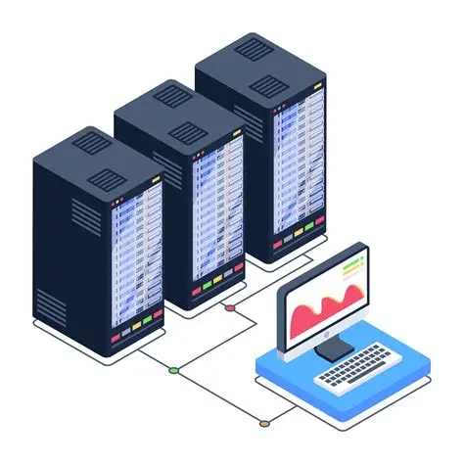

Conclusion & Future Scope
Future Enhancements
Simplified Management
The system significantly streamlines lost item handling on campus.
Student Logins
Personalized profiles and claim history for students.
Enhanced Transparency
Audit logs ensure accountability and build trust among users.
Automated Notifications
Email or SMS alerts for matching items or claim status updates.
Dedicated Mobile App
Native application for iOS and Android for on-the-go access.

